Slide 1

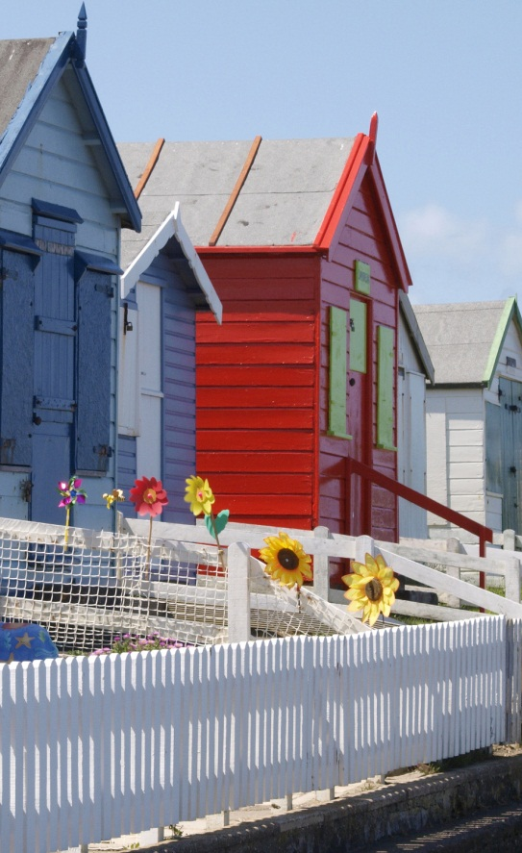
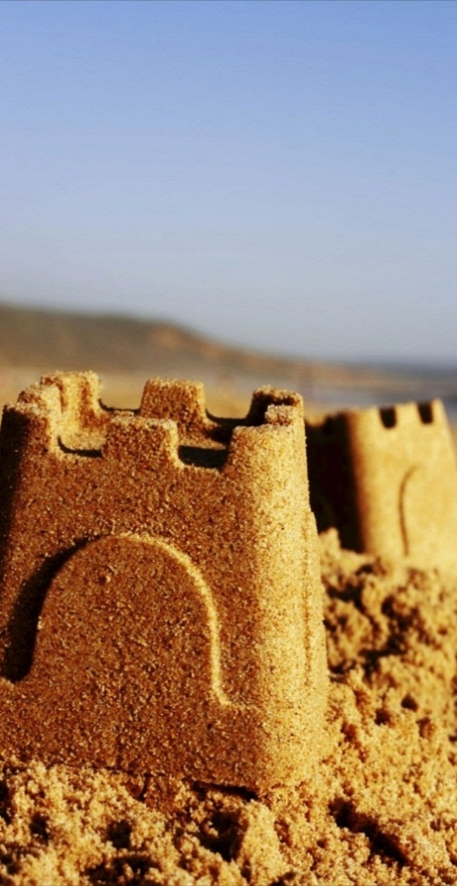
come and know the town Cundinamarca - colombia
"We recommend visiting our town to everyone who listens to us. They went ahead of all the needs and resolved everything that could have been stressful for us. "
~ Diana Cruz-
Come and know the town
Location: Cundimarca - Colombia
3163729912
Diana.cruz@pisosindustrialesjcr.com
People Of Cundinamarca

Slide 2
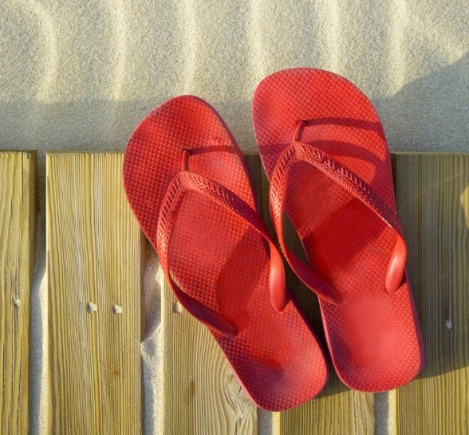
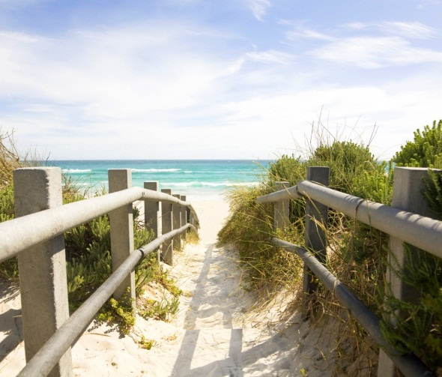
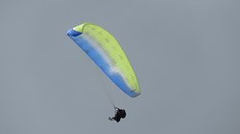
“We do not just book your trip to our town; we can help you make your dream journey a reality, if you give us an idea of what kind of experiences you are looking for in our town.”
Advantages of the town
Through our wide network of activities to carry out in our town, we offer quality activities services, which include:
passages with friends
Excursions
Transportation, hotel, pool, a few glasses of wine and parties
Farming - Inca peanuts
About us
This plant is cultivated in only five months, time in which the granate starts; finally to the seven it refines its production and also, as an advantage to those who dedicate themselves to its sowing, 90% of the harvest is destined for the international market. Reasons why, today is positioned in the national territory as an orange venture, ideal for the replacement of illicit crops.
Travel and know our beautiful town is the place you should go whenever you want to get going. At the service of all of Colombia for more than 20 years, we are proud of our high standards of service and our unparalleled reputation, achieved thanks to our courtesy and our good work.
Diana Cruz and her companions had never left Bogota and decided to leave to live a tropical adventure in Cundinamarca, but they were a little nervous about the possibility of falling ill or getting lost in another town.
Our people prepared an incident-proof vacation for them, including checklists, trusted contact persons on the vacation spot, and other resources. The comrades returned eager to enjoy more trips to the town of cundinamarca.
outdoor activities
Just 50 minutes from Bogotá you can enjoy Experiences such as paragliding, hiking, biking enjoying landscapes, playing in the Mountain Paintball field, and with the alternative of Restaurant, cafeteria, being an excellent place where you can rest and fulfill. One of the men's dreams. FLY !!

